Slide 1
Teaching History of Pharmacy According to the AIHP Guidelines:
F. Pharmacy Associations
Created by: James Colbert,
PharmD
UC San Diego, Skaggs School of Pharmacy and Pharmaceutical Sciences
Reviewed by: Susan Miller,
BS Pharm, PharmD, BCGP, FASCP
Mercer University College of Pharmacy and
David M. Baker,
BS Pharm, MBA, JD
Western New England University College of Pharmacy & Health Sciences
Developed by the Teaching History of Pharmacy Committee of the History of Pharmacy SIG, 2017-18
Picture: Pharmacist at People’s Drug Store No. 5, Washington, DC, c. 1920. Library of Congress Prints and Photographs, LC-USZ62-129891

Slide 2
Development of Pharmacy Associations in Italy - The Guilds
Ancient Roman times: seplasiarii – association (guild) for social and welfare purposes, and to regulate conditions of trade.
During Middle Ages, Italian guilds not only regulated themselves but also were political bodies with legal authority
Late 12th Century
  Physicians, pharmacists, and drug wholesalers were in the same guild; pharmacy was one of the 7 major arts - held in high esteem.
Notes:
NEVER ON SLIDE:
Seplasiarii = “shadowy” predecessors of pharmacists
During middle ages up to the 17th C., the guilds were integral to the city republics’ governance (unlike other European areas). Note: there is no unified Italy at that time.

Slide 3
Tasks of 12th-15th Century Italian Pharmacy Guild
1. Care of poor and/or sick members.
2. Introduction and job location of all who passed entrance exams.
3. Regulation of distance bet. pharmacies.
4. Regulation of remedy prices.
5. Collection of taxes.
6. Supervision of remedy producers and retailers.
Notes:
NOT ON SLIDE:
1. Care of poor and/or sick members.
2. Introduction and job location of all who passed entrance exams.
3. Regulation of distance bet. pharmacies.
4. Regulation of remedy prices.
5. Collection of taxes.
6. Supervision of remedy producers and retailers.

Slide 4
Evolution of British Pharmacy Associations
Under King James I:
  1607 - Apothecaries part of Grocers Company
  12/6/1617 - established Society of Apothecaries
  1632 – Society of Apothecaries built Guild Hall
1815 - Apothecaries Act - grouped physicians, surgeons and apothecaries together, separate from druggists and chemists, who only buy, compound and dispense drugs.
1841 - Pharmaceutical Society of Great Britain formed for druggists and chemists. Objectives:
  1. Advancement of pharmacy and chemistry
  2. Promotion of uniform education for druggists and chemists
  3. Protection of those who are druggists or chemists
  4. Relief of needy member, and widows and dependents

Slide 5
US Pharmacy Associations – the Beginning – the Philadelphia College of Apothecaries
Type of Association: Local
Where: Philadelphia, PA
Why:
  Location of oldest American school of medicine and most educated physicians
  J. Redman Coxe (March 1820), with University of Pennsylvania support, proposed a “Master of Pharmacy” degree/designation conferred by the medical school – received 16 druggists’ signatures
  U of P did confer 16 honorary Master of Pharmacy degrees, but no one took a single pharmacy course at the U of P

Slide 6
US Pharmacy Associations – the Beginning – the Philadelphia College of Apothecaries
Reaction:
  Meetings of prominent Philadelphia apothecaries – first in February 1821
  On March 13, 1821 formed the Philadelphia College of Apothecaries in Carpenter’s Hall
  In 1822, changed name to Philadelphia College of Pharmacy
Origin of name: College of Apothecaries:
  “College” from “Philadelphia College of Physicians” and English “Royal College of Physicians”
  “Apothecary,” then “Pharmacy” from:
    Apothecaries becoming physicians
    French and German use of pharmacist and pharmacy
Was a combination of a school, an association, and a publisher

Slide 7
US Pharmacy Associations – State Organizations
1867 – first – Maine Pharmaceutical Association – faltered and dormant till 1890
Often formed in response to medicine’s call for pharmacy legislation & regulation
Often business-oriented; separate from schools forming; most practitioners from apprenticeship
Mid-1900s: became more professional; integrated with national/local associations

Slide 8
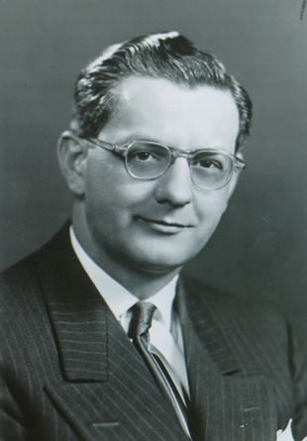
“It is my firm conviction that American pharmacy will not come into its own until we have a majority of our pharmacists actively supporting their national professional organization.”
Donald E. Francke 1910-1978

Slide 9
US Pharmacy Associations – National Organizations
1850s National Issue: adulterated drugs
Response:
  1851: Meeting called by NYCP (PCP, MACP, MDCP and CCP) – PCP, NYCP and MACP attended – PCP (Procter) proposed meeting to form national association
  October 6-8, 1852: Formed American Pharmaceutical Association – Daniel B. Smith, president and William Procter, Jr., secretary.
  Created Constitution and Code of Ethics

Slide 10
American Pharmacists Association (APhA)
Formed in 1852 as the American Pharmaceutical Association
Oldest and largest organization in pharmacy
Headquartered in Washington D.C.
APhA is the organization that the U.S. congress expects to speak for pharmacy
Involved in setting policy and standards of practice for all pharmacy settings
Has more than 62,000 members
APhA Vision inspires, innovates, and creates opportunities for members and pharmacists worldwide to optimize medication use and health for all
APhA Mission as the voice of pharmacy, leads the profession and equips members for their role as the medication expert in team-based, patient-centered care
Member of the Joint Commission of Pharmacy Practitioners (JCPP)
Most other pharmacy organizations have ties to APhA

Slide 11
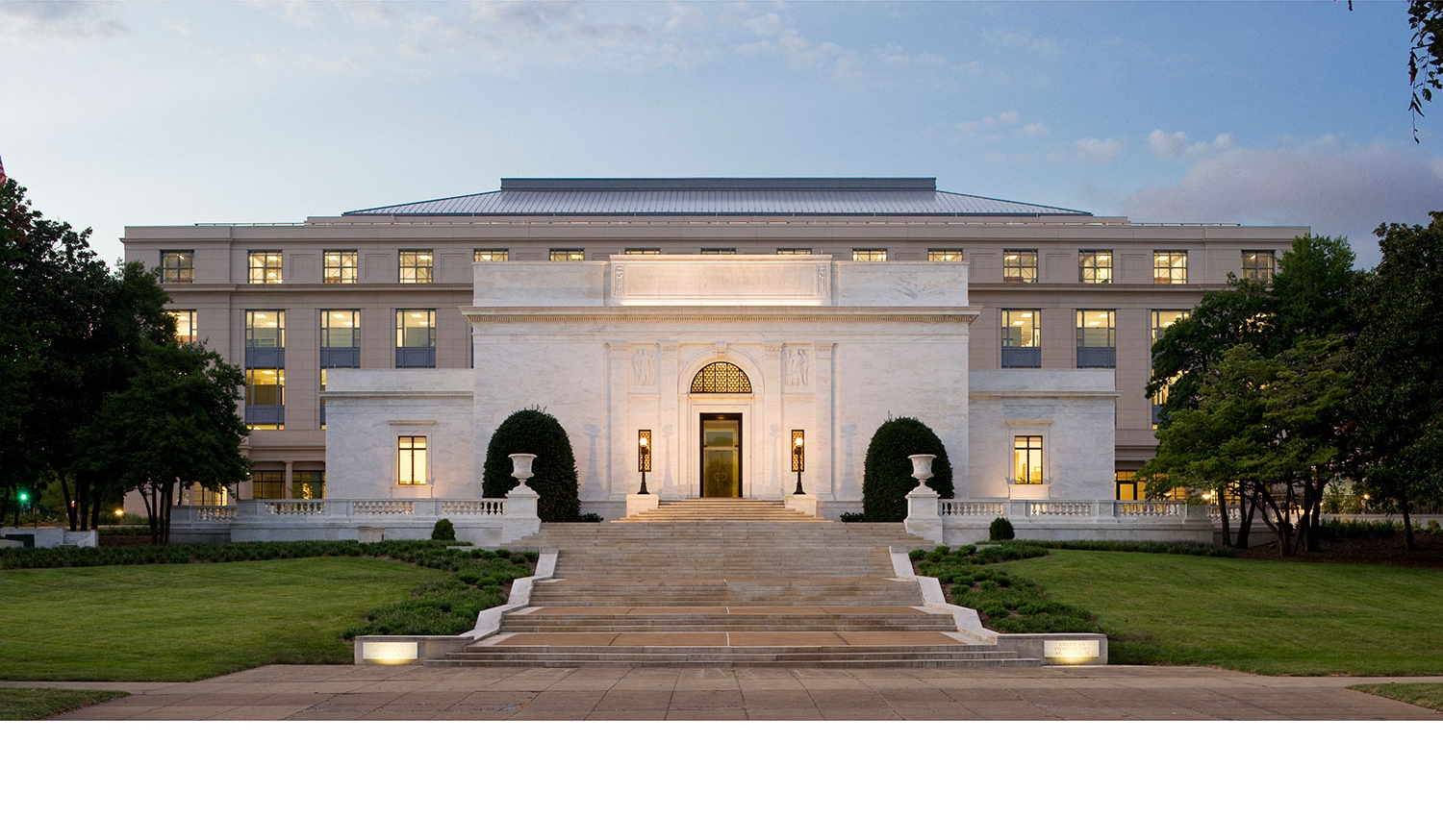
The APhA Headquarters Building – Washington, D.C.

Slide 12
Healthcare Distribution Alliance (HDA)
Founded on March 15, 1876 under the name Western Wholesale Druggists’ Association (WWDA). The name was changed to the National Wholesale Druggists’ Association in 1882, to the Healthcare Distribution Management Association in 2000, and to the Healthcare Distribution Alliance in 2016.
Mission is to protect patient safety and access to medicines through safe and efficient distribution; advocate for standards, public policies and business processes that enhance the safety, efficiency and value of the healthcare supply chain; and, create and exchange industry knowledge and best practices.

Slide 13
National Community Pharmacists Association (NCPA)
Founded in 1898 as the National Association of Retail Druggists (NARD)
Headquartered in Alexandria, Virginia
Represents the pharmacist owners, managers, and employees of more than 22,000 independent community pharmacies across the U.S.
U.S. independent pharmacies, independent pharmacy franchises, and independent chains dispense approximately 40 percent of the nation's retail prescription medicines
Serves as a champion for community pharmacy on Capitol Hill
Mission: Dedicated to the continuing growth and prosperity of independent community pharmacy in the U.S.
Has developed an aggressive student-outreach program aimed at educating students about pharmacy ownership
Member of the Joint Commission of Pharmacy Practitioners (JCPP)

Slide 14
National Association of Chain Drug Stores (NACDS)
Founded in 1933
The mission of NACDS is to advance the interests and objectives of the chain community pharmacy industry, by fostering its growth and promoting its role as a provider of healthcare services and consumer products.

Slide 15
American College of Apothecaries (ACA)
Founded in 1940
Headquartered in Bartlett, Tennessee
Has over 1000 members, from both U.S. and Canada
Primary focus is independent community pharmacy practice
Vision Dedicated to the advancement of professional practice in independent community pharmacy through entrepreneurship and mentoring.
Mission Dedicated to advancing the entrepreneurial spirit of member pharmacists through education, innovation, mentoring, fellowship and training
Member of the Joint Commission of Pharmacy Practitioners (JCPP)

Slide 16
American Society of Health-System Pharmacists (ASHP)
Founded in 1942 as the American Society of Hospital Pharmacists
Began as a subsection of hospital pharmacists at APhA in 1936
Changed name to American Society of Health-System Pharmacists in 1994
Headquartered in Washington D.C.
Has over 45,000 members
ASHP Vision is that medication use will be optimal, safe, and effective for all people all of the time.
ASHP Mission for pharmacists is to help people achieve optimal health outcomes
Best known as the primary organization for the accreditation of pharmacy residency programs
Member of the Joint Commission of Pharmacy Practitioners (JCPP)

Slide 17
National Pharmaceutical Association (NPhA)
Founded in 1947
The National Pharmaceutical Association is dedicated to representing the views and ideals of minority pharmacists on critical issues affecting health care and pharmacy, as well as advancing the standards of pharmaceutical care among all practitioners.

Slide 18
Pharmaceutical Research and Manufacturers of America (PhRMA)
Founded as the Pharmaceutical Manufacturers Association in 1958
Represents the country’s leading pharmaceutical industry research and biotechnology companies
Mission is to conduct effective advocacy for public policies that encourage the discovery of important, new medicines for patients by biopharmaceutical research companies.
Headquartered in Washington, DC

Slide 19
American Society of Consultant Pharmacists (ASCP)
Founded in 1969; the only international professional society devoted to optimal medication management and improved health outcomes for all older adults
Headquartered in Alexandria, Virginia
Represents over 9,000 pharmacy professionals
ASCP Vision is to achieve safe, effective, and appropriate use of medications by all older adults.
ASCP Mission involves empowering pharmacists to promote healthy aging through the appropriate use of medications.
Focuses on building relationships with other pharmacy, aging, and long-term care associations
Works closely with officials from the Centers for Medicare and Medicaid (CMS)
Member of the Joint Commission of Pharmacy Practitioners (JCPP)

Slide 20
American College of Clinical Pharmacy (ACCP)
Founded in 1979 by ASHP members who practiced clinical pharmacy at an advanced level
International organization
Headquarters in Lenexa, and Washington D.C.
Criteria for full membership are more restrictive than those of other pharmacy organizations
Strong relationship with the Board of Pharmaceutical Specialties (BPS)
ACCP Vision to drive positive changes in health care as the professional organization most influential in advancing clinical pharmacist roles and responsibilities to optimize pharmacotherapy in the prevention and treatment of disease
ACCP Mission is to improve human health by extending the frontiers of clinical pharmacy less through strategic initiatives, partnerships, collaborations, and alliances
Member of the Joint Commission of Pharmacy Practitioners (JCPP)

Slide 21
Professional Compounding Centers of America (PCCA)
Founded in 1981
Involves over 4,000 independent community pharmacies in the U.S., Canada, Australia, and other countries around the world
Headquartered in Houston, Texas
Mission is to help pharmacists and prescribers create personalized medicine that makes a difference in patients’ lives

Slide 22
American Association of Pharmaceutical Scientists (AAPS)
Founded in 1986
Formerly the Academy of Pharmaceutical Research Scientists of APhA
Represent pharmaceutical researchers (pharmacology, medicinal chemistry and pharmaceutics)
Mission: To advance the capacity of pharmaceutical scientists to develop products and therapies that improve global health
  Vision: Advancing the pharmaceutical sciences to drive prevention and cures.
  Five core values: Learning, Innovation, Service, Inclusiveness and Integrity.

Slide 23
Academy of Managed Care Pharmacy (AMCP)
Founded in 1989 representing over 8000 members
Headquartered in Alexandria, Virginia
Nation’s leading professional association dedicated to increasing patient access to affordable medicines, improving health outcomes and ensuring the wise use of health care dollars
Active membership available to all including pharmacists, physicians, nurses, physician assistants, students
AMCP Vision to improve health care for all
AMCP Mission to empower its members to serve society by using sound medication management principles and strategies to improve health care for all
Academy members manage medication therapies for the 270 million Americans served by health plans, pharmacy benefit management firms, emerging care models and government
Member of the Joint Commission of Pharmacy Practitioners (JCPP)

Slide 24
American Association of Colleges of Pharmacy (AACP)
The national organization representing the interests of pharmacy education founded in 1900
Headquartered in Alexandria, Virginia
The association includes institutional members - the 142 schools of pharmacy accredited by the Accreditation Council for Pharmacy Education
Represents more than 6,400 faculty, 62,500 students enrolled in professional programs and 5,100 individuals pursuing graduate study.
AACP Vision envisions a world of healthy people through the transformation of health professions education
AACP Mission is to advance pharmacy education, research, scholarship, practice and service, in partnership with members and stakeholders, to improve health for all
Member of the Joint Commission of Pharmacy Practitioners (JCPP)

Slide 25
Accreditation Council for Pharmacy Education (ACPE)
Founded in 1932, was originally called the American Council on Pharmaceutical Education
Not a government agency
Is the national accreditation agency for all U.S. pharmacy schools and all U.S. pharmacist continuing education programs.
ACPE initially established standards for the baccalaureate degree in pharmacy and then added the doctor of pharmacy standards as an alternative.
In 2000, ACPE announced the conversion to the doctor of pharmacy (PharmD) as the sole entry-level degree for the profession of pharmacy.

Slide 26
Board of Pharmacy Specialties (BPS)
In January of 1973, a Task Force on Specialties in Pharmacy was created by the American Pharmacists Association (APhA).
BPS was organized in 1976 as an independent certification agency of APhA.
Vision Statement: The Board of Pharmacy Specialties, the premier post-licensure certification agency, will ensure that BPS Board Certified Pharmacists are recognized within healthcare delivery systems while serving the needs of the public and the pharmacy profession.
Mission Statement: The Mission of the Board of Pharmacy Specialties is to improve patient care by promoting the recognition and value of specialized training, knowledge, and skills in pharmacy and specialty board certification of pharmacists.
Currently Recognized Specialties (12): Nuclear, Nutrition Support, Pharmacotherapy, Psychiatry, Oncology, Ambulatory Care, Critical Care, Pediatrics, Cardiology, Infectious Diseases, Geriatrics, and Compounded Sterile Products.

Slide 27
National Association of Boards of Pharmacy (NABP)
First attempt (1890-1892): Association of Boards of Pharmacy & Secretaries of State Pharmaceutical Associations
Founded 1904
Not a government agency
Members are board members of the U.S. state and territory boards of pharmacy
Represents all of the states’ boards of pharmacy
Responsible for maintenance of Model Pharmacy Practice Act
Maintains NAPLEX, MPJE, and PCOA examinations

Slide 28
American Institute of the History of Pharmacy (AIHP)
Founded in 1941 by:
  Dr. Arthur H. Uhl, Director of the UW School of Pharmacy
  Dr. Edward Kremers, Director Emeritus of the UW School of Pharmacy
  Dr. Louis W. Busse, Professor at the UW School of Pharmacy
  Dr. Lloyd M. Parks, Professor at the UW School of Pharmacy
  Jennings Murphy, Secretary of the Wisconsin Pharmaceutical Association
  Dr. George Urdang, former Director of the German Society of the History of Pharmacy
Mission is to advance knowledge and understanding of the history of pharmacy and medicines.
Headquartered at the University of Wisconsin-Madison
Membership is open to any who share an interest in the history of pharmacy.
Has extensive pharmacy archives – called the Kremers Files
Journal: Pharmacy in History

Slide 29
American Society for Pharmacy Law (ASPL)
Founded in 1974.
ASPL is the organization of attorneys, pharmacists, pharmacist-attorneys and students of pharmacy or law who are interested in the law as it applies to pharmacy, pharmacists, wholesalers, manufacturers, state and federal government and other interested parties.
ASPL is a nonprofit organization with the purposes of:
  Furthering knowledge in the law related to pharmacists, pharmacies, the provision of pharmaceutical care, the manufacturing and distribution of drugs, and other food, drug, and medical device policy issues;
  Communicating accurate legal educational information; and
  Providing educational opportunities for pharmacists, attorneys, and others who are interested in pharmacy law

